Slide 1

PROJECT PRESENTATION
2022

Slide 2
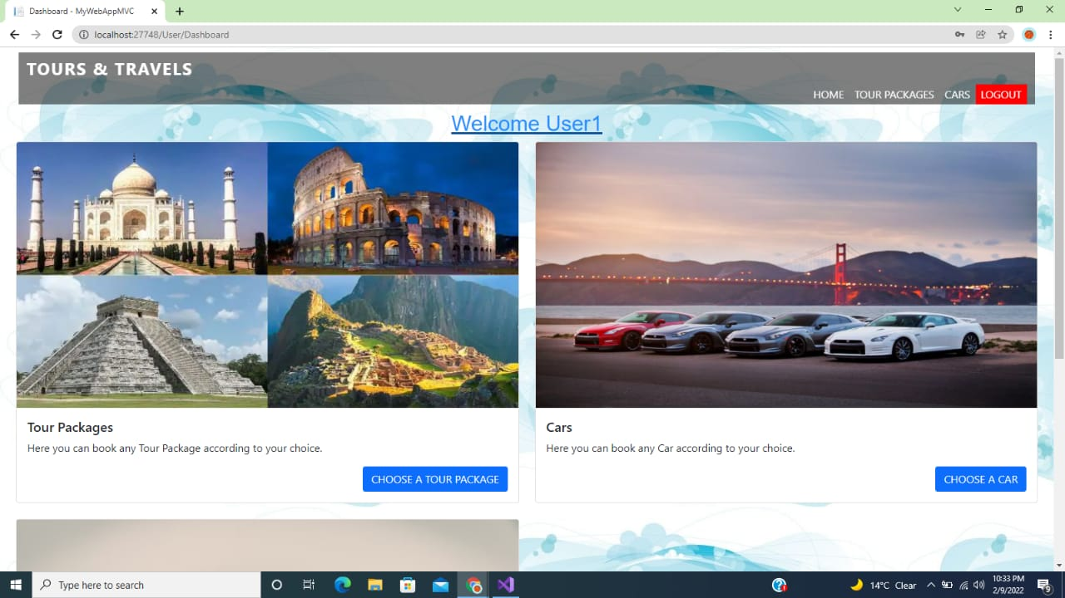

Slide 3
TEAM MENTOR
Dr. AMIT Kr GUPTA
Associate Professor
KIET Group Of Institutions , Ghaziabad
TEAM MEMBERS
PIYUSH KUMAR
PARAS SHARMA
KARAN DEV

Slide 4
A Trip To Remember
Introduction
A Trip to Remember is a web application which will provide online Tour Package booking and Car Rent booking. This application is for the travel agency in which there is an option of doing the ticket reservation in order to reach the intended destination. This application will help the customers to book the ticket. Booking of tickets will be done with a great ease and without any difficulty.

Slide 5
Description
Project Description
A Trip To Remember is a web application which provide user an ease way to book a ticket for any available Tour Package. A User can explore all the Tour Package and choose any package according.
In this project, we are using HTML, CSS, Javascript and C# programming languages for developing the application and for database management we are using Microsoft SQL Server.

Slide 6
Scope of the project
Scope of the project
(i) Accessible from anywhere
(ii) Open in all browsers and very easy to handle it..
(iii) Available to all and provide services to all..
(iv) Fast accessibility
(v) Packages are represented with all the required details.

Slide 7
HARDWARE and SOFTWARE REQUIREMENTS
HARDWARE REQUIREMENTS
Processor :Dual Core 2nd generation RAM : 2GB or more
HARD DISK : 80GB
OPERATING SYSTEM: Windows 7 and Above
Software Requirements FRONT END:
Html,CSS,JavaScript

Slide 8
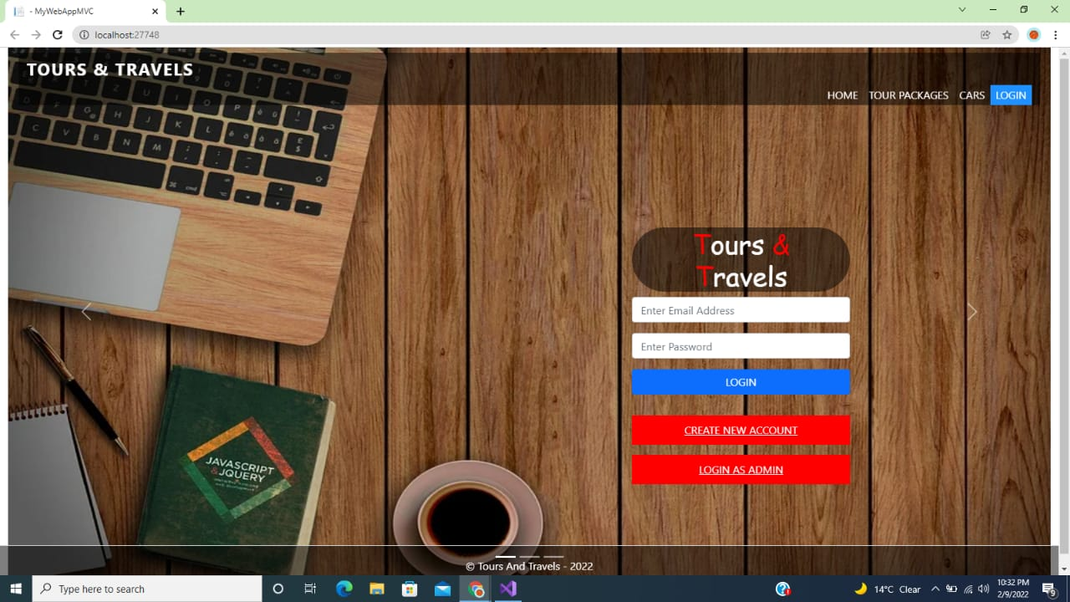
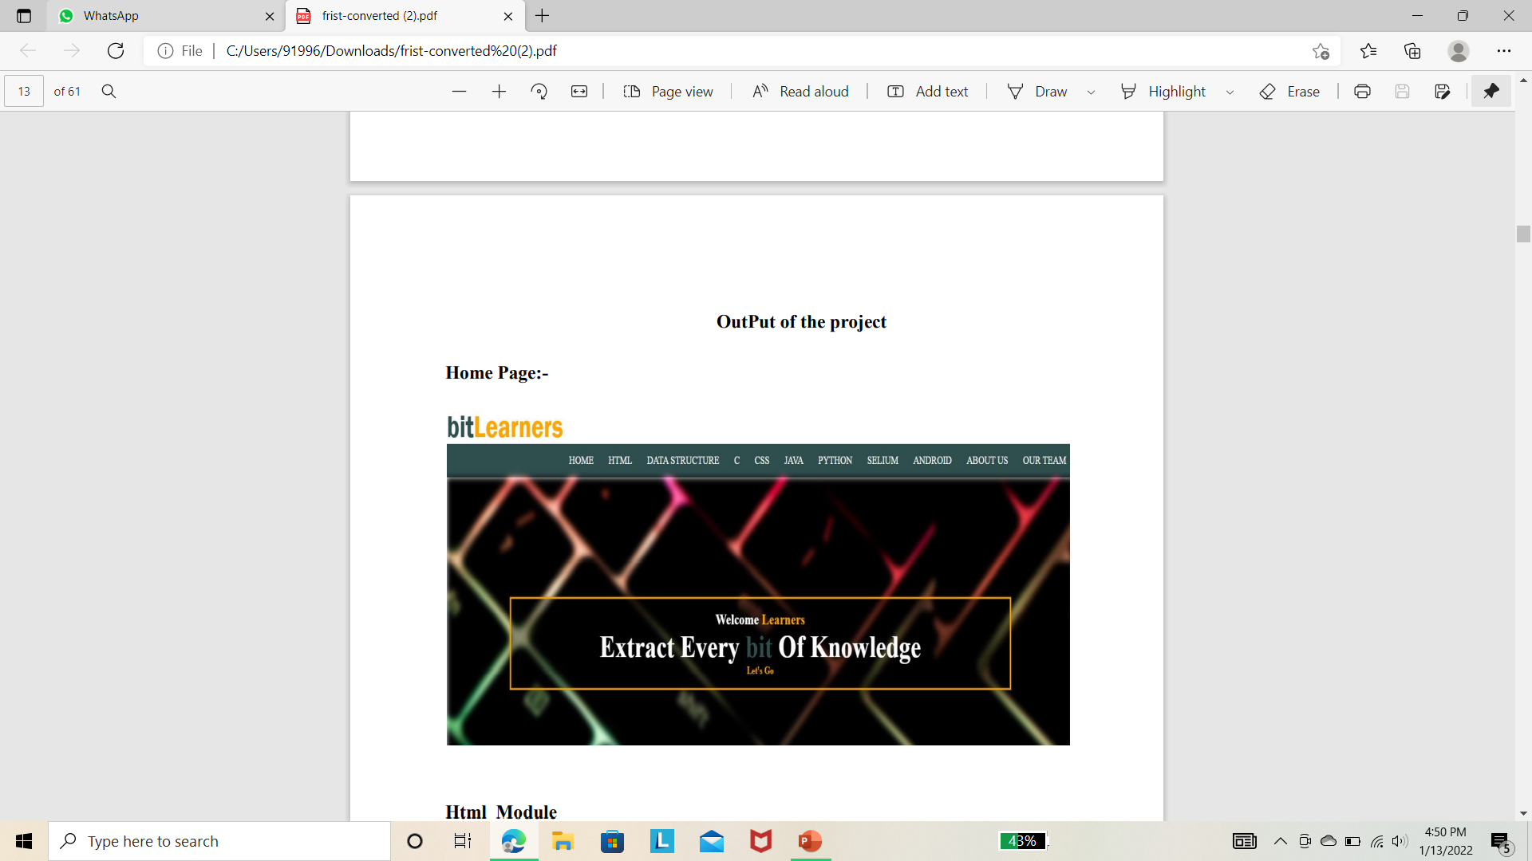

Slide 9
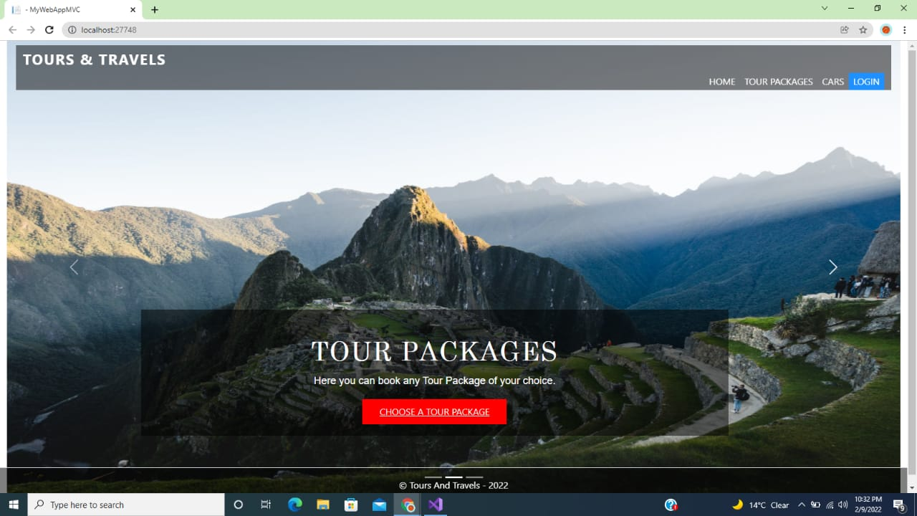
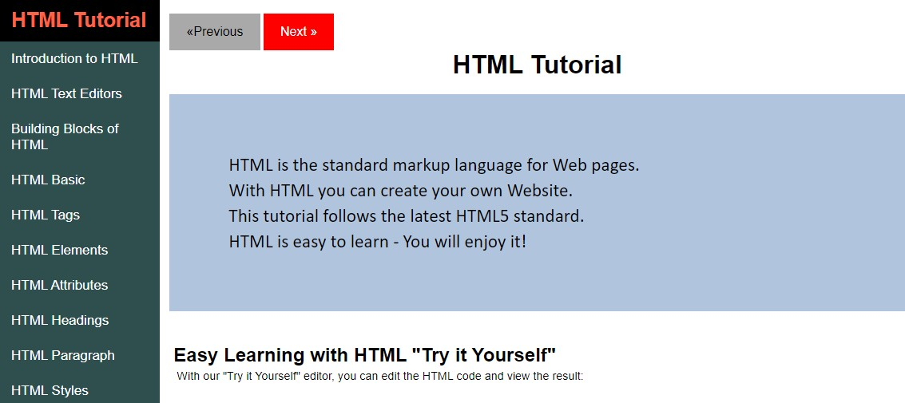
HTML Tutorial

Slide 10
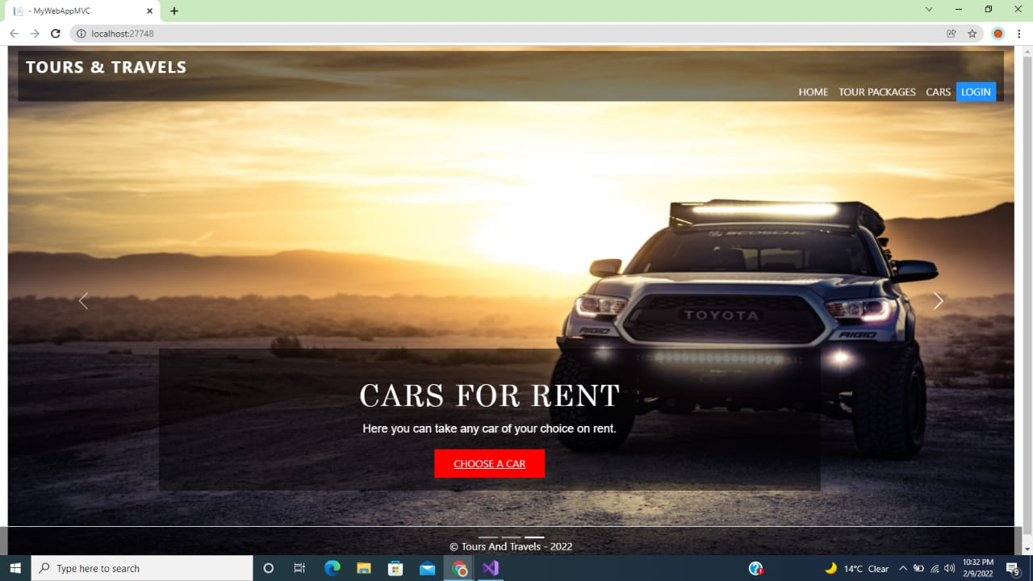
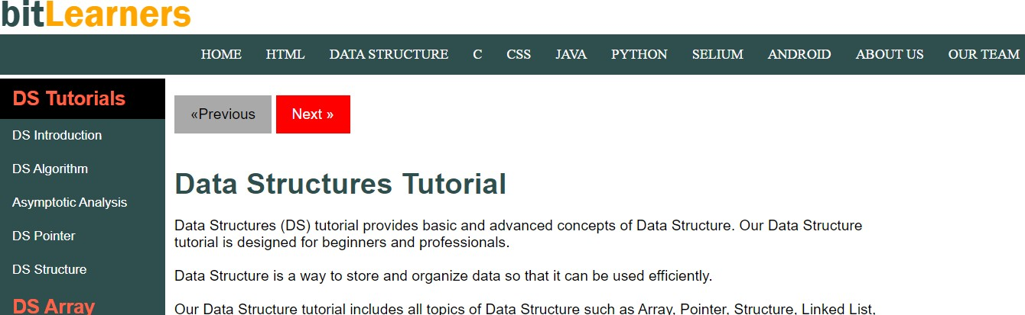
DS Tutorial

Slide 11

ProList

Slide 12

Visiting

